Slide 1
如何做好演讲型PPT

Slide 2
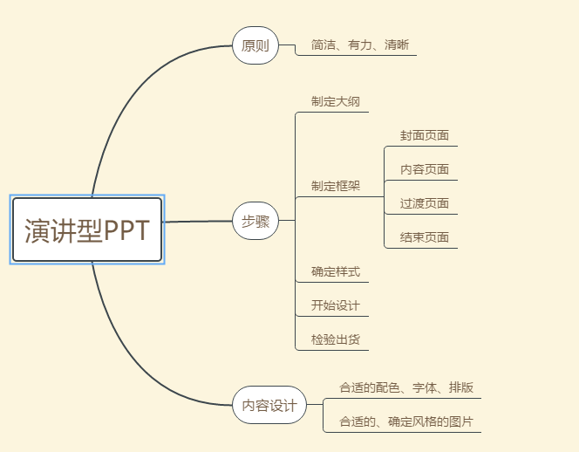

Slide 3
字体的选择
等线
微软雅黑
微软雅黑 Light
方正兰亭黑简
华文黑
冬青黑

Slide 4
毛笔字体的选择
潮字社小石繁

Slide 5

使用图层蒙版
* 使用图层蒙版使得背景弱化，文字更加好看

Slide 6
* 图片素材：https://pixabay.com/
* 图片素材：http://wallhaven.cc/
* 设计素材：huaban.com
* 设计素材：http://699pic.com/
**其他**：
https://www.ifanr.com/app/692268
https://www.ifanr.com/app/655328

Slide 8
1
请在此输入您的标题
1
type your title here

Slide 9
1
请输入你的标题
 | 产品A | 产品B | 产品C
销 量 | 69.5万套 | 58.5万套 | 70.3万套
营业额 | 6943.05万元 | 2281.5万元 | 3936.8万元
成 本 | 2048万元 | 1024万元 | 1904.2万元
毛利润 | 4895.05万元 | 1257.5万元 | 2032.6万元
净利润 | 1543.1万元 | 950.2万元 | 554.4万元

Slide 10
1
请输入你的标题

Slide 11
2
请在此输入您的标题
2
type your title here

Slide 12
2
请输入你的标题
点此插入文字
点此插入文字
There is no road in the world, and there are many people who have gone.
There is no road in the world, and there are many people who have gone.
插入公司logo
点此插入文字
点此插入文字
There is no road in the world, and there are many people who have gone.
There is no road in the world, and there are many people who have gone.

Slide 13
3
请在此输入您的标题
3
type your title here

Slide 14
3
请输入你的标题
请输入文字
请输入文字
There is no road in the world, and there are many people who have gone.
There is no road in the world, and there are many people who have gone.
请输入文字
请输入文字
There is no road in the world, and there are many people who have gone.
There is no road in the world, and there are many people who have gone.

Slide 15
4
请在此输入您的标题
4
type your title here

Slide 16
4
请输入你的标题
插入图片
插入图片
插入图片
插入图片
请输入文字
There is no road in the world, and there are many people who have gone.
请输入文字
There is no road in the world, and there are many people who have gone.
请输入文字
There is no road in the world, and there are many people who have gone.
请输入文字
There is no road in the world, and there are many people who have gone.

Slide 17
5
请在此输入您的标题
5
type your title here

Slide 18
5
请输入你的标题
右击插入图片
请输入文字
请输入文字
请输入文字

Slide 19





感谢聆听
插入二维码
插入二维码
XXXXXX公司
XX市XX区XXXX
+86 0571-88888888

